Slide 1
Pre-Retirement Seminar

Slide 2
Overview
How your pension is calculated
Eligibility
Ways to increase your pension
Pension options
Integration with CPP and/or OAS
Life and dependents insurance
Online Services
Decisions at retirement
Applying to start your pension
What to expect after you start your pension
Adjustments to your pension after retirement
Notes:
The pre-retirement seminar cover these topics:

Slide 3
Civil Service Superannuation Pension
This is a defined benefit pension plan.
Employees contribute a percentage of earnings to the plan and accrue a pension. Employers also fund a portion of the benefits earned.
The pension is determined using a formula that uses service and earnings. Your pension amount does not directly depend on what you contributed.
Notes:
We will begin with some background information on how your pension plan works. The CSSF pension is a "defined benefit" pension plan, which means your pension benefit is determined using a formula. The formula is based on two factors and those are your pensionable service and your earnings.
Members contribute a percentage of their earnings to the plan and employers also fund a portion of those benefits earned.
With a defined benefit plan, the contributions made to the plan do not determine the pension benefit you receive, but they help fund that pension.
Some of you may be familiar with a "defined contribution" plan where the benefit is defined by the contributions and interest accruing in the plan, similarly to an RRSP. With a defined contributions plans, the member contributes a certain percentage of their earnings and the employer matches it, but the value at retirement, depends on how investments grow over time. That’s not the case with your defined benefit plan.
Generally, the longer you work and the higher the salary you earn, the higher your pension will be when you retire.
If you meet all eligibility requirements, the earliest you can receive your pension is the month following your 55th birthday. Another important detail is that you must commence pension benefits no later than December 31st of the year you turn age 71.
Employees contribute are 8% on salary up to CPP maximum and 9% on salary over the CPP maximum
Salary = regular earnings and vacation pay
CPP Maximum = the maximum earnings used to determine
CPP benefits

Slide 4
Pension Depends on Service
Qualifying Service
Used to determine benefit eligibility
Generally measured from start date to end date
Unbroken unless there’s been a suspension of more than 54 consecutive weeks
Pensionable Service
Used to determine the pension payable
Actual service on which contributions are made
May be able to be enhanced by purchasing service or by transferring service from another pension plan (if eligible)
Notes:
So we've spent some time discussing a "defined benefit" plan and the employee contribution rate, but I also want to concentrate on the two types of service that your pension also depends on: one is "Qualifying Service" and the other is "Pensionable Service."
Your qualifying service is used to determine benefit eligibility. It's generally measured from your start date to your end date. It is ultimately your period of employment to your end date, which could be your retirement date, your termination date, or your date of death.
It's unbroken unless there's been a suspension of service in excess of 54 consecutive weeks. Again, qualifying service is not used to calculate your pension, it's used to determine benefit eligibility and used for early retirement. In our pension plan, attaining 10 years of qualifying service is quite significant and we will discuss the importance later in the presentation.
Your Pensionable Service is used in the formula to determine the pension payable and it is the actual service on which you contribute to the pension plan. It may be enhanced by purchasing service or by transferring service from another pension plan, if eligible.
To summarize, your Qualifying Service is used to determine benefit eligibility, whereas your Pension Service is used to determine the pension payable.

Slide 5
Service Example
Year Pensionable Service Qualifying Service
2025 (June 30) .2500 .5000
2024 .5000 1.0000
2023 .5000 1.0000
2022 .5000 1.0000
2021 .5000 1.0000
2020 .5000 1.0000
2019 .5000 1.0000
2018 .5000 1.0000
2017 .5000 1.0000
2016 .5000 1.0000
2015 (July 1) .2500 .5000
Total 5.0000 10.0000
Employee working
half time
Notes:
Let's review an example for an employee working half time. You can see on the left-hand side the years the service we are using and for this example, we are using 10 years. For a member retiring part-way through the year, the current year is only being credited to June 30. You can see the difference in our column for Pensionable Service and for the Qualifying Service.
Again, your Pensionable Service is counted as long as you are making contributions. Your Qualifying Service is counted every day you were an employee.
So the Pensionable Service at the bottom totaling five years is because the employee is only working half time and they are only contributing into the pension plan while they are working part-time.
Whereas when we look at your Qualifying Service for every day you're an employee, it’s showing the 10 years of Qualifying Service, which again, is quite significant. You can retire anytime after 55, with minimal reduction when you’ve reached 10 years of Qualifying Service.

Slide 6
Pension Depends on Earnings
The pension formula uses an average of your highest five years throughout your career.
The salary used to determine your average are your regular earnings as provided by your employer.
Pensionable earnings include:
retroactive salary adjustments,
banked vacation days cashed out at retirement,
"deemed" salary while receiving disability benefits (depending on your employer).
Pensionable earnings exclude:
earnings while working under contract
overtime
severance pay
Notes:
The pension formula uses an average of your highest five years throughout your career.
Your salary used to determine your average are your regular earning as provided by your employer.
Your pensionable salary typically includes any retroactive salary adjustment with the exception that you’ve transferred out your funds. The earnings impacted by the MGEU contract settlement in the fall of 2022 will be included when calculating your best five years if they fall within that range.
The lump sum you receive when you cash out your vacation days at retirement are pensionable and used in your average.
Depending on your employer, if you’re in receipt of the long term disability and accruing a pension benefit while in receipt of CSSB disability allowances, the reported earnings will be used in your pension calculation.
Your pensionable salary excludes any earnings while working under contract or when working overtime. Your employer doesn’t report your severance pay as it is not pensionable.

Slide 7
Example - Calculate Best 5-Year Average Salary at December 31, 2025
Year | Service | Salary | CPP Pensionable Salary
2025 | 1.0000 | $78,000 | $71,300
2024 | 1.0000 | $75,000 | $68,500
2023 | 1.0000 | $71,000 | $66,600
2022 | 1.0000 | $65,000 | $64,900
2021 | 1.0000 | $64,000 | $61,600
Average |  | $70,600 | $66,580
Notes:
Let's take a look at an example of a calculation of the best 5-year average salary for a member retiring at the end of the year.
In this example, for simplicity, we are using the last 5 years, but remember it doesn't have to be.
We’ve listed the years we are using in the average on the left-hand side.
Again for simplicity, this member was credited with a full year of service for each year. We indicate the CPP Pensionable Salary for those same years along the far-right hand side.
At the bottom you can see the calculated best 5-year average salary and CPP average salary if a member were to retire at the end of the year.

Slide 8
Example - Calculate Best 5-Year Average Salary at June 30, 2025
Year | Actual Service | Annual Salary | CPP Pensionable Salary | Portion of Year Used | Portion of Salary Used | CPP Pensionable Salary Used
2025 | .5000 | $78,000 | $71,300 | .5000 | $39,000 | $35,650
2024 | 1.0000 | $75,000 | $68,500 | 1.0000 | $75,000 | $68,500
2023 | 1.0000 | $71,000 | $66,600 | 1.0000 | $71,000 | $66,600
2022 | 1.0000 | $65,000 | $64,900 | 1.0000 | $65,000 | $64,900
2021 | 1.0000 | $64,000 | $61,600 | 1.0000 | $64,000 | $61,600
2020 | 1.0000 | $60,000 | $58,700 | .5000 | $30,000 | $29,350
Average |  |  |  | 5.0000 | $68,800 | $65,320
Notes:
Here's another example of the best 5-year average salary calculation if a member is retiring part way through the year.
In this example we will take a portion of service of that partial year. So along the left-hand side there are the years that we are using 2024 all the way to 2019 but for 2024 we're only taking a portion of that year used, which is .5000 because a retirement date as of June 30 is halfway through the year.
We're only going to take a portion of that year and the years prior are going to be credited at a full year, and we're going to go all the way previously to 2019 and take a portion of that year at .5000 which gives us the average of the best 5-years.
You will notice under the salary column, we're only going to take half of the salary for that year, because the member only worked and contributed to the pension up to June 30. At the bottom you can see that the best 5-year average salary is calculated.

Slide 9
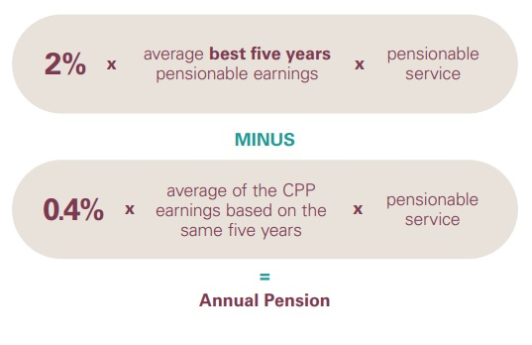
Your Pension Formula
Pension Calculation
video segment available
Notes:
Now let's look at the Annual Pension Formula. Remember your pension is a defined benefit plan, and your contributions do not determine what you receive at retirement. We use a formula to determine the pension payable from the Fund. The formula is based on two important factors – your pensionable service and your average salary.
The formula is 2% multiplied by average best five-year pensionable earnings. As mentioned before, this salary is over your career, it does not have to be consecutive. Multiplied by your pensionable service, again this is the actual service on which you contributed to the pension plan.
Minus 0.4% multiplied by the average CPP pensionable earnings, which is using the same period taken from the best 5-year pensionable earnings, multiplied again by the pensionable service, the actual service on which you contributed to the plan.
What is important to understand is that your pension benefit is determined by a formula and the two factors that drive the formula are service and salary.
Note this does not include Manitoba Hydro Enhanced Pension. Also, pensions are subject to maximums as required by the Income Tax Act.
________________________________________________________________________________
This slide shows how we determine what you will receive from the pension.
Even though we just reviewed your contributions – you don’t see those anywhere on this slide as your pension doesn’t depend on your contributions. But the CPP earnings do come into play once again.
Your contributions help fund the pension benefit along with your ER share – but don’t determine the benefit.
Your CSSF pension is a defined benefit plan, and we use a formula to determine the pension payable. The formula is based on two important factors – your pensionable service and your average salary.
The formula is: 2% multiplied by the average of your best five-year of pensionable earnings - Multiplied by your years of pensionable service. This salary is over your career, it does not have to be consecutive.
Minus 0.4% multiplied by the average CPP pensionable earnings, which is using the same 5 year period, multiplied again by your years of pensionable service.
Annual pension is then divided by 12 which provides your gross monthly pension – payable for your lifetime.
What is important to understand is that your pension benefit is determined by a formula and the two factors that drive the formula are pensionable service and pensionable salary.
You don’t need to work through the formula as we can run pension estimates by using the Pension estimator through OLS.

Slide 10
Example - Pension Calculation
Retirement Date: December 31, 2025
Employee Age: 55
Pensionable Service: 30 years
Average Salary: $70,600
Average CPP
Pensionable Earnings: $66,580
.02 x $70,600 x 30 = $42,360.00
Less: .004 x $66,580 x 30 = $7,989.60
Annual Pension of = $34,370.40
Monthly pension $2,864.20*
*Lifetime pension option and assumes no early retirement reduction (Rule of 80).
Notes:
Let’s take a look at a Pension Calculation. We’ll be using the averages and values discussed in the previous slides.
In this case, we are going to use a retirement date of December 31. The employee's age is 55, and the pensionable service accrued is 30 years. We established the average salary on the previous slide, which is $67,000, and the average CPP pensionable salary is $64,060.
So when using those factors in the formula, we take .02 and multiply that by the average salary and then multiply that by the years of pensionable service. It works out to $40,200
Then we minus .004 multiplied by the average CPP pensionable salary, multiplied again by the same 30 years of pensionable service, and that works out to be $7,687.20. Therefore the annual pension is $32,512.80 or if you divide that by 12, a monthly pension of $2,709.

Slide 11
WHEN CAN I RETIRE?
Age, Service and Retirement Date
video segment available

Slide 12
Retire with an unreduced pension
Between age 55–59 and your age + service is 80 or more
At age 60+ with 10 or more years of qualifying service
At age 65+ with no minimum service requirement (Possible increase in pension for retirements after age 65)
*Correctional officers as early as age 50 with rule of 75. Must have been contributing extra 1% for minimum 5 years.
Notes:
When planning for retirement, the first decision to make is choosing your date of retirement. In our plan, members may retire at any time throughout the year.
Members are eligible to retire with an unreduced pension if they retire between the ages of 55 and 60 and their age plus qualifying service equals 80 or more
Or
You retire at age 60 or older with 10 or more years of qualifying service
Or
You retire at age 65 or older.
If retiring on or after age 65 there could be a possible increase in your pension. If you are entitled to this increase it will automatically be included in the amount you receive. Please note that our pension estimator (through online services as well as the one we use in office) does not include this increase. For an estimate of a possible increase, please contact the Superannuation Board office directly.
Correctional officers can retire as early as age 50 with the Rule of 75, however they must have been contributing an extra 1% to the pension plan for a minimum of 5 years.

Slide 13
Retire with a reduced pension: 10 or more years of qualifying service
Between age 55-59 and your age + service is less than 80:
Reduction may be up to a maximum of 3% per year prior to the earlier of meeting Rule of 80 or age 60, whichever occurs first.
Bridging Benefit payable until age 65, if applicable.
Notes:
Now if you retire between the ages of 55 and 59 and you have not met your Rule of 80, then the Income Tax Act requires an early retirement reduction be applied to your pension. Your pension is reduced by 1/16% for benefits earned up to January 1, 1992 and 1/4% for benefits earned after January 1, 1992. The Income Tax Act allows us to compensate for the increased early retirement penalties in the form of an additional temporary pension called a “bridging benefit”.
This bridging benefit allows members to retire with a reduction to their pension that is effectively ¾% per year for every year they retire prior to age 60 or meeting their “Rule of 80”, whichever is less. This is not something you need to apply for and is not to be confused with CPP/OAS integration. We determine if you are entitled to receive it, and if so, it will automatically be paid to you. Note that as per the Income Tax Act, the bridging benefit is only payable until the age of 65.
If impacted by higher reduction under the Income Tax Act for service after 1991, difference is converted to a Temporary Additional Allowance (a.k.a. “bridging”)
Bridging is paid only to age 65

Slide 14
Retire with a reduced pension: Less than 10 years of qualifying service
Between age 55-64:
Actuarial reduction applied. Pension is actuarial equivalent in value to the pension you would otherwise receive at age 65.
Approximately 6% for each year prior to age 65:
~60% reduction if retiring at age 55
~30% reduction if retiring at age 60
Notes:
As we saw on the previous slide, 10 years of qualifying service is significant in our plan in that it allows you to retire as early as age 55 with a minimal reduction to your monthly pension.
If you are retiring between the ages of 55 and 64 with less than 10 years of qualifying service, then an actuarial reduction is applied. This reduction is approximately 6% for each year you retire prior to the age of 65. So if you are 55 years old there is an approximate 60% reduction to your pension, if you are 60 years old there is an approximate 30% reduction.
If this does apply to you when you retire, you have the option to not immediately start collecting your pension and instead leave it in the Superannuation Fund as a deferred pension until the age of 65. At age 65 these reductions no longer apply and you are then eligible for an unreduced pension (note: life insurance coverage does not continue with a deferred pension, however you can convert it to an individual policy with Canada Life if you wish).
When determining the best time to start collecting your monthly pension, keep in mind that the reduced value prior to age 65 is the actuarial equivalent of the value payable at age 65. Consider whether you want to collect a smaller pension for a longer period, or delay collecting it to receive a higher value.

Slide 15
WAYS TO INCREASE
YOUR PENSION

Slide 16
Service and Earnings
Increasing these variables will increase your pension
Pensionable Earnings:
Cashing out banked vacation days
Increase regular salary
Pensionable Service:
Purchase/transfer service
If your pensionable service is lower than qualifying service, you may be eligible to purchase service.
Notes:
Pensionable earnings and pensionable service are the two variables used to calculate the pension.
Naturally, the easiest way to increase your pension would be to increase your annual salary but increasing your salary isn’t always an option.
So, you maybe eligible to increase your pension by purchasing pensionable service.
The cost to purchase pensionable service is dependent upon the type of buyback eligible.
Applications must be received in our office prior to termination of employment or retirement.
There is no obligation to purchase after applying and can cancel at anytime.

Slide 17
Increasing Pensionable Earnings: Vacation Days
A lump sum payment for vacation is subject to pension contributions (8% or 9%). Gross vacation earnings can be included in pensionable salary when you cease to be an employee.
Limited to the amount of vacation days earned in the last two years and an overall maximum of 50 days.
This can increase pensionable salary in the final year, which usually increases pension benefits, often by 4 or 5%.
Check with your employer about banking and cashing out your vacation days and to get an estimate of vacation days earned in your last two years.
Vacation Cash Out
video segment available
Notes:
Vacation earnings are added to your regular pensionable earnings, so it boosts your total pensionable earnings in your last year of work. This impacts your 5-year average, which in turn increases your monthly pension, If you are able to set aside the maximum of 50 days, it typically increases a monthly pension by 4-5% on average for the rest of your life. So having unused vacation days can be quite significant when it comes to your pension.
You will need to connect with your employer/payroll department since they are ultimately responsible for the accrual of your vacation time and how they allow you to bank your vacation days for pension purposes.
The number of vacation days you can set aside depends on your regular vacation accrual. It is limited to the amount of days earned in the last two years, and up to an overall maximum of 50 days. So someone who works half time won’t be able to bank 50 days because they accrue vacation at half the amount of time of someone who works full time – so the maximum vacation days for that half time worker is going to be 25 days.
Our online estimator has a feature where you can include or exclude whatever number vacation days so you can see the impact with and without vacation days.

Slide 18
Example - Calculate Best 5-Year Average Salary at December 31, 2025
No Vacation Days
50 Vacation Days
Year | Service | Salary | CPP Pensionable Salary
2025 | 1.0000 | $78,000 | $71,300
2024 | 1.0000 | $75,000 | $68,500
2023 | 1.0000 | $71,000 | $66,600
2022 | 1.0000 | $65,000 | $64,900
2021 | 1.0000 | $64,000 | $61,600
Average |  | $70,600 | $66,580
Year | Service | Salary | CPP Pensionable Salary
2025 | 1.0000 | $93,000 | $71,300
2024 | 1.0000 | $75,000 | $68,500
2023 | 1.0000 | $71,000 | $66,600
2022 | 1.0000 | $65,000 | $64,900
2021 | 1.0000 | $64,000 | $61,600
Average |  | $73,600 | $66,580
Notes:
Here we will look at an example of the impact on the 5-year average of someone who retires at the end of the year with and without 50 vacation days.
First is an example of a 5-year average for someone who has zero vacation days. The average salary shown is $67,000
Next let’s look at an example of a 5-year average for someone who has 50 vacation days. The 2023 salary includes a vacation cash out of $14,423 which increased the overall 2024 salary to $89,423. This will add up to a higher average salary of $69,885

Slide 19
Example - Pension Calculation - 50 Vacation Days
Retirement Date: December 31, 2025
Employee Age: 55
Pensionable Service: 30 years
Average Salary: $73,600
Average CPP
Pensionable Salary: $66,580
.02 x $73,600 x 30 = $44,160.00
Less: .004 x $66,580 x 30 = $7,989.60
Annual Pension of = $36,170.40
Monthly Pension with 50 vacation days = $3,014.20
Monthly Pension with no vacation days = $2,864.20
Increase to monthly pension = $150.00
*Lifetime pension option and assumes no early retirement reduction (Rule of 80).
Notes:
Here another example of the pension calculation but now including 50 vacation days. We have the same member retiring at the end of the year, they are 55 with 30 years of pensionable service, and now we are using the 5-year average from that earlier example assuming 50 vacation days which was $66,534, and the CPP average being $61,840.
Let’s plug that data into the formula. First, we take .02 multiplied by the average salary, multiplied by 30 years of pensionable service. Which works out to $39,920.
Then we take .004 multiplied by the average CPP pensionable salary, multiplied again by the same 30 years of pensionable service, and that works out to be $7,420. The difference coming out to the annual pension of $32,499, then simply divide that by 12 to arrive at the monthly pension of $2,708.

Slide 20
Example - Calculate Best 5-Year Average Salary at June 30, 2025
No Vacation Days
50 Vacation Days
Year | Service | Salary | CPP Pensionable Salary
2025 | 0.5000 | $39,000 | $35,650
2024 | 1.0000 | $75,000 | $68,500
2023 | 1.0000 | $71,000 | $66,600
2022 | 1.0000 | $65,000 | $64,900
2021 | 1.0000 | $64,000 | $61,600
2020 | 0.5000 | $30,000 | $29,350
Average |  | $68,800 | $65,320
Year | Service | Salary | CPP Pensionable Salary
2025 | 0.5000 | $54,000 | $35,650
2024 | 1.0000 | 75,000 | $68,500
2023 | 1.0000 | $71,000 | $66,600
2022 | 1.0000 | $65,000 | $64,900
2021 | 1.0000 | $64,000 | $61,600
2020 | 0.5000 | $30,000 | $29,350
Average |  | $71,800 | $65,320
Notes:
Here we will look at an example of the impact on the 5-year average of someone who retires at the end of the year with and without 50 vacation days.
First is an example of a 5-year average for someone who has zero vacation days. The average salary shown is $65,400
Next let’s look at an example of a 5-year average for someone who has 50 vacation days. The 2024 salary includes a vacation cash out of $14,423 which increased the overall 2024 salary to $51,923. This will add up to a higher average salary of $68,285.

Slide 21
Increasing Pensionable Service
Prior Non-Pensionable Employment (PNE)
Service before January 1, 1984
Service Transfer/Reciprocal Transfer Agreements (RTA)
Prior Service - Reinstatement
Reduced Hours in Last Five Years of Employment
Special Service Buy Back (SSBB)
Purchasing Service
video segment available
Notes:
Here are some different ways to increase your pension permitted by The Civil Service Superannuation Act:
Prior Non-Pensionable Employment PNE would apply to service before January 1, 1984. This application is made through your payroll department.
Year-round to Seasonal, this would apply if your employer changed your work frequency from year-round to seasonal. In that case, you are eligible to contribute to the Fund based on your higher pensionable service immediately before the seasonal employment. The application to contribute must be made prior to beginning the leave.
If the service purchase doesn't fall under any other provision, then it may be purchasable under a Special Service Buy Back, we will discuss these in more detail on the next slides.
A Reciprocal Transfer Agreement (RTA) is an agreement between two pension plans that allows eligible members to transfer pensionable service to a new pension plan. The Board has entered into Reciprocal Transfer Agreements with many pension plans in Manitoba and across Canada. To be eligible to transfer service under an RTA, you must have terminated employment under the exporting plan, be a member of the importing plan and apply within the timelines of the specific agreement.
If you previously contributed and have re-entered the Plan, you may be eligible to reinstate your prior account. Reinstatement is the option of combining pensionable service from a prior Fund account into a new Fund account, which allows the pension for the prior period to be determined including the salary in the new account.
I’d like to mention that if an employee is permitted by the employer to defer their salary, the deferred salary paid is NOT pensionable earnings. There would not be any contributions deducted from these earnings and would not accumulate service during this period of leave.
Again you must be an employee to apply and it must be purchased prior to retirement. The cost will depend on the type of service, when you apply, and there's no obligation to proceed. We will provide you with information on the cost and the increase to your pension so that you can decide whether you want to proceed.

Slide 22
Special Service Buy Back
May purchase prior periods of non-pensionable service and periods of leave or lay-off.
Terms and Conditions
employer was and is currently participating in the Fund
contract service is not included
service cannot be purchased under any other provision of the Act
Cost
full actuarial cost of the service to be purchased calculated at the date of application
Application
available Online or from the CSSB office
no obligation and may be cancelled at any time
Notes:
Special Service Buy Back (SSBB) allows employees to purchase eligible periods of employment that are not already pensionable and are no longer eligible for purchase under the pension plan’s other service purchase arrangements.
Example: You were on maternity and/or parental leave 10 years ago, applied to purchase but wasn’t affordable at that time. Purchasing now would fall under a Special Service Buy Back.
Some terms and conditions are:
that the employer was and is currently participating in the Fund,
contract service is not included,
- Income Tax legislation limits the amount of eligible service that can be purchased.
Applications are available through our website, in the Special Service Buyback Estimator in your online services account or can contact our Board office. There is no obligation and you can cancel your application at any time.
The cost to purchase service through SSBB is the full actuarial cost based on your salary, age and actuarial assumptions in effect at the date of application. The employee pays the full cost, with no employer funding.
Typical processing time is between 8-12 weeks but may take longer if we require information from your employer. As with the online SSBB estimate, we’ll prepare an estimate of the pension increase including the cost, to help you decide if it’s worthwhile for you to purchase the service.

Slide 23
Special Service Buy Back
approximate cost/benefit to purchase one year of service
(effective January 1, 2025)
Annual Salary | Age |  |  | Monthly Increase
 | 50 | 55 | 60
$50,000 | $8,792 | $10,343 | $11,994 | $67
$60,000 | $10,550 | $12,412 | $14,393 | $80
$70,000 | $12,309 | $14,480 | $16,792 | $93
Notes:
Here we have a diagram outlining the estimated cost per benefit for a Special Service Buy Back including the approximate cost to purchase one year of service effective January 2025.
On the far left-hand side, we show the annual salary and across the top you have your age in years, and on the far right side, it shows the estimated increase in monthly lifetime pension.
Example:
You are 40 years old, your annual salary is $50,000 so you would used the chart to find the match point for cost and pension increase amount. In this case the cost to purchase one year of service is approximately $7,317.
Looking to the far right-hand side, the estimated increase in your monthly lifetime pension is $67 a month. Keep in mind we're only showing this as a lifetime pension, we're not showing any other pension options available.
A listing with more salaries is available at our website or can obtain an estimated cost/benefit using the SSBB estimator in your online services account.

Slide 24
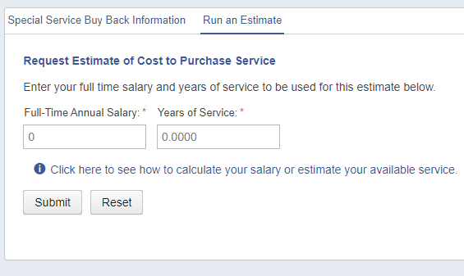
Online Services SSBB Estimator
Notes:
Members who are registered for Online Services have access to a Special Service Buy Back (SSBB) Estimator. They can run their own SSBB cost estimate and see the resulting pension increases.
Click "Special Service Buy Back" on the left hand side of the menu screen to start the estimator.

Slide 25
Service Purchase Payment Options
Lump sum payment by cheque or e-transfer
Transfer from a Registered Retirement Savings Plan (RRSP) or a Manitoba Locked-in Retirement Account (LIRA)
Bi-weekly installments
Lump sum payment and bi-weekly amounts paid to purchase service may be tax deductible.
There is no obligation to proceed with the purchase once you apply.
For SSBB and PNE, the transfer of vacation cash out or severance pay are also options of making payments - contact your employer for more information.
Notes:
The cost to purchase this service will be outlined in a letter including the estimated increase to your pension at your unreduced retirement date. This will enable you to decide whether this is an advantage to you. You are not obligated to make the payment.
For most service purchases, payments can be made by any of the following methods:
- lump sum by personal cheque,
direct transfer from your RRSP or Manitoba LIRA,
bi-weekly installments from your pay,
e-transfer,
any combination of these methods.
Lump sum payments and bi-weekly instalments may be tax deductible.
We can accept after tax vacation cash out or severance pay at retirement from your employer.

Slide 26
PENSION OPTIONS
Pension Options
video segment available
Notes:
Selecting your plan option will likely be one of the most important decisions you will need to make once you have decided to retire.
Understand these options so that you can select the one that best meets your personal needs and retirement goals.
When making your decision, consider…
Financial commitments – do you need more income now because you still have a mortgage or kids in university?
Life expectancies for you and your partner – health and family history are important factors
Other sources of income
Employment income – are you planning in working part-time into retirement or starting your own business?
CPP and/or OAS – are you going to access those benefits when eligible?
Investments – do you have RRSPs? Do you want to access them now or let them grow with interest?
Other pensions
Life insurance
Dependants – do you have a younger family?
Lifestyle – what are you plans into retirement? Are you planning on traveling or staying to close to home to babysit your grandkids?

Slide 27
Pension Options
How your pension is paid to you, then to a surviving spouse or beneficiary on your death.
Pension options available depend on your marital status at retirement
Cannot change option once pension is in pay
A member who is married/common-law must be paid a pension that provides a minimum 2/3 survivor benefit on death, unless:
Living separate and apart by reason of the breakdown of the relationship, or
Spouse or partner signs a waiver form within the 60 days prior to the pension commencement date
Notes:
What is a pension option?
As per the pension formula, your pension is initially calculated as a lifetime pension. This is the value you will see on your annual pension statement. At retirement, other options are available.
A member who is married or in an eligible common-law relationship must be paid a pension that provides a minimum 2/3 survivor benefit on death, unless:
they are living separate and apart by reason of the breakdown of the relationship, or
Their spouse or partner signs a waiver form within the 60 days prior to the pension commencement date
So, Manitoba pension legislation states we have to leave at least 2/3 of our pension to our spouse/partner. The only two pension options in our plan that do not require a waiver form are the 2/3 to Survivor and Full to Survivor options (I’ll go into more detail on all the pension options available on the next slide). If you elect any option other than a 2/3 or Full to Survivor, then your spouse/partner must sign the waiver form , called a Form 5A, any time when within 60 days of your date of retirement. It’s important to note the timelines of this waiver form as if it’s signed outside of the 60-day window (either before or after) then it is not valid and you will not be able to elect a pension option leaving less than 2/3 to spouse.
If completing your retirement forms through online services, the Form 5A will automatically print at the end with your Application For A Monthly Pension when you finish completing your forms and have elected a pension option that requires the Form 5A to be completed. If you have requested a paper package from our office then this form will be automatically be included if you have a spouse whether or not you require it.
Selecting your plan option will likely be one of the most important decisions you will need to make once you have decided to retire.
Understand these options so that you can select the one that best meets your personal needs and retirement goals.
When making your decision, consider…
Financial commitments – do you need more income now because you still have a mortgage or kids in university?
Life expectancies for you and your partner – health and family history are important factors
Other sources of income
Employment income – are you planning in working part-time into retirement or starting your own business?
CPP and/or OAS – are you going to access those benefits when eligible?
Investments – do you have RRSPs? Do you want to access them now or let them grow with interest?
Other pensions
Life insurance
Dependants – do you have a younger family?
Lifestyle – what are you plans into retirement? Are you planning on traveling or staying to close to home to babysit your grandkids?

Slide 28
Lifetime
Full pension payable for your lifetime only with no continuing payments
Single or married/common-law
Unused contributions, if any, are paid to your estate.
Notes:
Why would you consider this option?
You are single with no dependants
You are not concerned about leaving an estate
You are healthy
You are in a relationship where you are both financially independent
You have a partner who is much older or has a shorter life expectancy
You have a partner that is expecting an inheritance

Slide 29
Minimum 10 or 15-Year
Reduced pension payable for your lifetime
If you pass away within the minimum guarantee period, your pension will continue to your named beneficiary(ies) for the balance of the guarantee period.
Single or married/common-law
Beneficiary(ies) can be anyone
Notes:
Why would you consider this option?
You’re a member who has serious health concerns and do not expect to live past the guarantee period
You are single with a partner who does not meet the legal definition of common-law spouse or partner
You are single/married with a dependant such as a parent, sibling or child
You have a partner who is much older or has a shorter life expectancy
Let’s look at an example where a member, already widowed at the time of her retirement, is the guardian of her 12-year-old grandson. She selected Plan Minimum 15-year guarantee because it gives her peace of mind knowing that her grandson is guaranteed monthly payments until age 27 if she passes away within the first 15 years.

Slide 30
1/2 to Survivor
Reduced pension payable for your lifetime. After your death, your spouse/partner will receive 1/2 of your pension for their lifetime.
Married or common-law
Beneficiary must be spouse/partner
Notes:
Why would you consider this option?
Your partner has other income in retirement and does not need your full survivor pension
Your partner is likely to pass away before you, but you want to protect your partner in the event you unexpectedly pass away first
Let’s look at an example of a member whose spouse did not need her pension income as he owned a lucrative business. Even though he was financially independent, she wanted to provide him with some additional income. Plan F allowed her to do so.
***If you’re married or common-law, all the pension options discussed to this point would require the Form 5A Waiver***

Slide 31
2/3 to Survivor
Reduced pension payable for your lifetime. After your death, your spouse/partner will receive 2/3 of your pension for their lifetime.
Married or common-law
Beneficiary must be spouse/partner
Notes:
Why would you consider this option?
Your partner is a member of another pension plan and will have their pension paid in a similar form
You want to provide adequate income to your partner if you should pass away first, but the full amount is not required for your partner
Let’s look at an example of a member whose spouse had a company pension. His pension provides him with the full amount for life and his spouse with 2/3 upon his death – this is a common pension type. She then selected 2/3 to Survivor as this pension option was like his plan and they wanted to equalize the retirement income for both.

Slide 32
Full to Survivor
Reduced pension payable for your lifetime. After your death, your spouse/partner will receive your full pension for their lifetime.
Married or common-law
Beneficiary must be spouse/partner
Notes:
Why would you consider this option?
Full to Survivor leaves the highest amount to the spouse if you pass away first
You are not in good health
You have a partner with little or no retirement income
You have a young family and want to provide income security for them in case something happens to you
You want to protect your partner with more security in the worst-case scenario
As an example, a member whose husband is self-employed and has no pension may opt for the Full to Survivor to ensure he receives a full pension for life if she (the member) passes away first.

Slide 33
Sample cost to provide pension options
Pension Option | Amount of Pension | Cost to Provide to beneficiary | Amount to beneficiary on death of member
Lifetime* | $1,000 | n/a | n/a
Minimum 10 year* | $992 | $8 | $992 for balance of 10 years
Minimum 15 year* | $983 | $17 | $983 for balance of 15 years
1/2 to Survivor* | $960 | $40 | $480
2/3 to Survivor | $948 | $52 | $632
Full to Survivor | $924 | $76 | $924
Member and spouse/partner both age 55
* Form 5A Waiver required if married/common-law
Notes:
This slide provides you with some sample costs. In our example, we are assuming that both the member and their spouse/partner are 55 years of age and that the value of their pension, as per the pension formula, is $1,000 per month. Keep in mind this is just an example. The pension values and costs will be different for every member.
As you can see, with the Lifetime pension option, the member receives the full value of their pension. There is no cost to ensuring an amount payable to a beneficiary as there is no beneficiary.
With the Minimum 10 Year, there is a small cost of $8 to the member, reducing the member’s pension to $992 per month. This ensures the beneficiary will continue to receive $992 per month for the balance of the 10 years following the member’s death.
With the Minimum 15 Year, the cost to the member is slightly higher - $17 – as we are now guaranteeing an amount payable to a beneficiary for a longer period – the balance of 15 years. The member receives $983 per month, ensuring the beneficiary continues to receive $983 per month for the balance of the 15 years following the members death.
The Survivor options have higher costs associated with them as we are now leaving an amount payable to a spouse/partner for the rest of their lifetime.
Important to remember…
Selecting a plan option is a personal decision
Cannot change a plan option once you receive your first payment
Cannot change beneficiary under 2/3rds, ½ and full to Survivor
Single members:
Pension option Lifetime, Min 10yr and Min 15 yr
Married/common-law members: All pension options
Spouse/partner¹ must be beneficiary under 2/3rds, ½ and full to Survivor
Common-law relationship is defined under legislation
Registered under The Vital Statistics Act
One year of cohabitation in a conjugal relationship if neither is married
Three years of cohabitation in a conjugal relationship if either is married
A special option is a personalized payment option where you design and personalize your payment plan to suit your needs.
A special option is a joint survivor option, payable for the lifetime of both you and your spouse. You can change the percentage paid after the first death or add a guarantee period to any joint survivor plan option to design your personal plan.
Some examples special options with a change in percentage might be:
80% to Survivor if a full pension is not needed but 2/3 to Survivor is too low
You could also add a 10 or 15-year guarantee to any joint survivor options. The full pension is paid for the guarantee period even if both spouses have passed away. Once the guarantee period expires, the plan reverts to the original joint survivor option.
The special option works particularly well if you have younger children and want to provide for them if you should both pass away.
You may choose a personalized option more suitable to your needs
May only be calculated if retiring within the current calendar year
Examples:
Change the percentage paid, e.g., 80% to Survivor
Add a guarantee to an existing option, e.g., Full to Survivor with a 10-year guarantee
With the ½ to Survivor pension option the cost to the member is $40. The member receives a reduced pension of $960/month. Upon the member’s death their spouse/partner will continue to receive 1/2 of their pension or $480/month.
With the 2/3 to Survivor pension option the cost to the member is $52. The member receives a reduced pension of $948/month. Upon the member’s death their spouse/partner will continue to receive 2/3 of their pension or $632/month.
The last option, the Full to Survivor pension, has the highest cost associated with it - $76. The member receives a reduced pension of $924/month. Upon the member’s death their spouse/partner will continue to receive the exact same amount.

Slide 34
INTEGRATION OPTION
Integrate your CSSF pension with
Canada Pension Plan (CPP) and/or
Old Age Security (OAS)
Integration
video segment available
Notes:
Welcome to our segment on Integration. Integration is an option that you will have to consider in preparation for your retirement. If eligible, you may elect to integrate with Canada Pension Plan (CPP) and/or Old Age Security (OAS). This segment will cover the details of how this option works, an example, important points to consider, and how you can find out what your personal integration figures look like.

Slide 35
Integration Option – How it works
A payment option allowing for a higher CSSF pension initially and a reduced pension later
CSSF pension is reduced for your lifetime
at age 60 for CPP integration
at age 65 for OAS integration
May help you level out your retirement income from these different sources
CSSF pension, CPP and OAS
Notes:
Considering the Integration Option is one of the key decisions you’ll make when preparing for retirement. Integration is a payment option that allows you to receive a higher pension from us initially in your earlier years of retirement, and then a reduced pension later on. These reduction points occur at age 60 for integration with CPP and then at age 65 for integration with OAS. And these reductions are for your lifetime.
Think of Integration in the concept of a loan. When we pay you a higher pension initially, what’s involved is we are paying you an advance of your own Superannuation Fund monies at retirement. And then at age 60 and/or at age 65, we start collecting back on that loan. However, with integration, we collect back for your lifetime – in other words, there will be a point reached where we have collected back all the monies you were advanced but we keep collecting back for your lifetime. The repayment amount is based on life expectancies, so it’s possible to pay back more or less than what you received in advances, again depending on how long you live.
The theory behind integration is that it’s meant to help provide an overall level retirement income from all three sources. Next up we will take a look at examples of both a non-integrated and integrated pension.

Slide 36
Without Integration
Contact Service Canada directly for information or to apply for CPP and OAS benefits.

Slide 37
With Integration
Contact Service Canada directly for information or to apply for CPP and OAS benefits.

Slide 38
Comparison of Heather and James
Heather and James are twins and held the exact same position and earnings throughout their entire career.
They both retired on their 55th birthday with 30 years of pensionable service and their gross monthly payments are also the exact same, $3,000 a month.
Heather decided to not integrate her pension.
James decided to integrate his pension with CPP and OAS.

Slide 39
Heather and James’ monthly CSSF pension income
Heather (without integration)
James (with integration)
age | monthly pension
55 | $3,000
60 | $3,000
65 | $3,000
70 | $3,000
75+ | $3,000
age | monthly pension
55 | $3,692
60 | $3,195
65 | $2,488*
70 | $2,488*
75+ | $2,488*
Monthly pension will be higher initially then lower at 60 and 65.
*Reduced pension for life after 65.
Monthly pension will stay steady at $3,000 for life.

Slide 40
Who would receive more if they both passed away at age 70?
Heather (without integration)
CSSF pension income from age
55 to 70
$540,000
James (with integration)
CSSF pension income from age 55 to 70
$562,500
James would have received $22,500 more pension income than Heather

Slide 41
Who would receive more if they both passed away at age 75?
Heather (without integration)
CSSF pension income from age
55 to 75
$720,000
James (with integration)
CSSF pension income from age 55 to 75
$711,780
Heather would have received $8,220 more pension income than James

Slide 42
Who would receive more if they both passed away at age 85?
Heather (without integration)
CSSF pension income from age
55 to 85
$1,080,000
James (with integration)
CSSF pension income from age 55 to 85
$1,010,340
Heather would have received $69,660 more pension income than James

Slide 43
Integration Option – Points to Consider
Life expectancy and financial needs
Reductions occur regardless of how much you receive from CPP and OAS when they are paid
CSSB does not apply on your behalf
Adjustments apply only during the member’s lifetime
Form 5B – Consent for Integrated Pension
Optional. You’re eligible to integrate
with CPP if you retire before age 60
with OAS if you retire before age 65
Cannot change decision once pension is in pay
Notes:
Considering whether to integrate your pension is a personal decision that you would have to make as a member at the time of retirement. It’s important to understand that in addition to it being personal decision, it’s also a permanent decision because once your pension has started, you cannot change it.
The reductions are going to occur at age 60 and 65 regardless of how much your CPP and OAS will be and when you actually receive those benefits. You must apply in advance with Service Canada directly to start those federal benefits; our office does not apply on your behalf.
When you’re considering integration the advances and reductions apply only during your lifetime. If you pass away, any increases or decreases to your CSSF pension, resulting from the integration option, would cease. If you are married or in a common-law relationship and you elect to integrate your pension, pension legislation requires your spouse/partner to complete a consent form which would be included with your retirement forms.
A friendly reminder that Integration is entirely optional, you do not have to integrate. You would be eligible to with CPP if you retire before age 60, you would be eligible to integrate with OAS if you retire before age 65, you would be eligible to integrate with both CPP and OAS if you retire before age 60, or of course none of the above.
To learn what your personal integration figures look like, you can start by requesting a pension estimate from our office or you can run a pension estimate yourself through your CSSB online services account.
Why would you choose to integrate?
Integration provides an opportunity to increase your cash flow earlier in retirement
You may have greater expenses such as travel, children living at home/still in university, or a mortgage
You may want to delay accessing your personal investments – let your RRSPs grow
It may enable you to retire at an earlier age – best reason – you need to retire and you can’t without the integration advance
Why would you choose not to integrate?
You plan to work after retirement and earn additional income – why take the advance/loan and get taxed when you can earn that income –
It’s on a need basis - you wouldn’t go to the bank for a loan simply if you wanted the additional income – it’s because you need the income
You plan to use your Registered Retirement Savings Plan or other investments to supplement your income until you become eligible for CPP and OAS – take the RRSPs rather than integration loan
You do not need the additional income
Integration increases your taxable income in earlier years

Slide 44
Alternative Transfer Option
The lump sum payable:
actuarial present value of your future pension
increases significantly at age 55 with 10 years of service
Locked-in funds transferable to a LIRA or LIF
No retiree life insurance but conversion option available
Proceed at your own risk
Online Termination Estimate
Notes:
At retirement, member’s have the option to elect a monthly pension or transfer the lump sum value out of the plan. If transferring, the majority of your funds will be locked-in. You can transfer them to either a LIRA (locked-in retirement account) or LIF (life income fund) with a financial institution.
It’s important to note that the transfer value increases significantly at age 55 with 10 years of service as ancillary benefits, the pension plan’s early retirement provisions, are included at that time. If you are leaving employment and are just under the age of 55 or have just less than 10 years of service I recommend contacting our office to discuss the implications to your pension.
The Income Tax Act limits the amount that can be transferred on a tax sheltered basis. Anything over and above the allowable limit must be paid as a taxable cash payment. If you have RRSP room available you may apply to the Canada Revenue Agency for permission for us to withhold less taxes at source. This application form is called T1215 form and can be located on the CRA website.
If transferring the funds out of the plan, life insurance does not continue. You can, however, convert to an individual policy with Canada Life by contacting them within 60 days of your date of retirement.
We say proceed at your own risk as once you transfer the funds out of our plan you assume the investment risk in making them work for your lifetime. If considering this option you may wish to obtain advice from a financial planner.
Check with your employer to determine if this impacts any other benefits you may be entitled to receive. For example, severance benefits.
You can obtain an estimate of your transfer value by running a termination estimate through online services.
The process for transferring your funds out of the pension plan is different than when you elect a monthly pension option. If electing a monthly pension, ideally we want you to return your completed forms 4-6 weeks prior to date of retirement. When transferring your funds out of the plan, we cannot provide you with transfer forms until after you have left employment. We have to wait for your employer to provide us with your final service and salary by way of an end of service report. They won’t send this to us until after they have paid everything out that is owing to you. Therefore it will be several weeks before we receive the end of service report. Once we receive it, legislatively we have up to 60 days to provide you with a package, you then have 120 days to complete and return it to us. Therefore you should plan for a minimum of 3-6 months following your date of retirement without this income.
If you decide to transfer the lump sum value of your pension upon retirement, please let our office know prior to your date of retirement so that we can place a note on your file to ensure we send you the applicable forms.

Slide 45
LIFE AND DEPENDENTS INSURANCE
Life Insurance
video segment available

Slide 46
Life Insurance in retirement
Payable on your death to your named beneficiary(ies)
Continues automatically if you had coverage at retirement and you commenced your pension
You cannot change your class of insurance after retirement
CSSB will provide you with a schedule showing insurance amounts for each year to age 73
From age 73, no further contributions are required and coverage of $6,000 remains in effect
You may at any time elect to be insured for $6,000 with no further contributions
Notes:
In retirement, group life insurance continues automatically if you had coverage at retirement and immediately commenced your pension.
After your date of retirement you cannot change you class of insurance. When planning for retirement it is important to review your coverage. If you feel you have too much or too little coverage and want to change your class, you must do so prior to your date of retirement by contacting your payroll department.
Our office will provide you with a schedule showing how your insurance changes in retirement. Your coverage reduces according to a set schedule. After the age of 73 your coverage remains at $6,000 and you do not make any further contributions.
At any time, at retirement or any time after retirement, you can elect to immediately reduce your coverage to $6,000 and not pay any further premiums. Once you reduce your coverage you cannot again increase it.
.

Slide 47
Coverage Changes
Life Insurance coverage changes in retirement as follows:
Age % of salary x class
under 60 75
60-64 60
65-69 40
70-72 15
73 and over $6,000 no charge
Monthly cost is 23¢/$1,000 of insurance
Notes:
This chart shows how your coverage changes in retirement.
If retiring prior to the age of 60 your life insurance coverage automatically reduces to 75% of your pre-retirement coverage.
At age 60 it further reduces to 60%, at age 65 to 40% and at age 70 to 15%. Your premiums also reduce accordingly. After the age of 73 your coverage remains at $6,000 and you do not pay any further premiums.
The monthly cost is 23 cents per $1,000 of coverage and is no longer cost shared with the employer.

Slide 48
Dependents Insurance in retirement
Payable to you on the death of a covered eligible dependent
Optional to continue or cancel at retirement
Number of Units | 1 | 2 | 3 | 4
Spouse/partner | $8,750 | $17,500 | $26,250 | $35,000
Each Child | $1,750 | $3,500 | $5,250 | $7,000
Monthly Contribution | $3.48 | $6.96 | $10.44 | $13.92
Eligible child: under 22, single, living in North America
Stops at spouse/common-law partner reaching age 70 or upon divorce
You may cancel your Dependents Insurance at any time
Notes:
This slide now reviews the dependents insurance following retirement. You have the option to continue this insurance into retirement and it continues from what you had as an active employee.
In this case, it automatically reduces by half of the coverage you had when you were an active employee. So if we take a look at the number of units on the top, we have your spouse and each child listed and it' shows that same schedule that we looked at on the previous slide but the only difference is those amounts of coverage have reduced by half of what it was on the previous slide as an active employee.
You're also going to notice that the monthly contribution is no longer a biweekly contribution but it's a monthly contribution and those amounts are noted at the bottom. Again the definition for child is under the age of 22, single and living in North America. For your spouse, it stops once they reach age 70.
You have the option to cancel your Dependents insurance at any time, but we will need this in writing.
I’d like to add this along with the decision in key area #4, continuing your life insurance, because if you do have Dependents insurance this is another decision you have to make. Now the main decision you have to make with Dependents insurance is whether to continue it based on the monthly contribution and the number of units you see here, or, whether to cancel it. If you wanted to change the number of units that has to be done prior to retirement when you're an active employee.

Slide 49
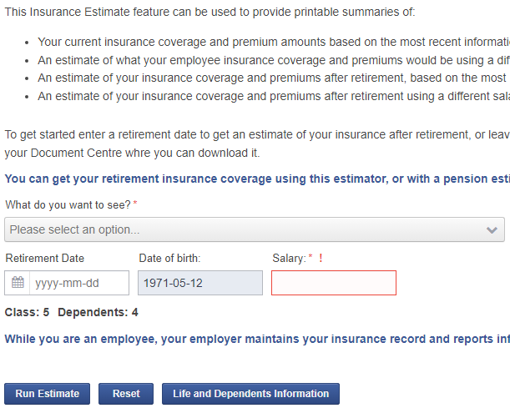
Online Services Dashboard
Notes:
If you have not already registered for online services, I encourage you to do so. Here you will be able to run your own life insurance estimate.

Slide 50
Waiver of Premiums & Conversion
Waiver of Premiums
Employees who terminate or retire due to ill health or injury may apply for waiver of premiums.
If approved, Life and Dependents insurance continues as if employed until the earlier of age 65, death or recovery, at no cost. At age 65, retirement provisions apply.
Conversion
Life and Dependents insurance (spouse only) can be converted to a private policy within 60 days of termination or retirement.
Notes:
Employees who terminate or retire due to ill health or injury may apply for a waiver of premiums. It is important to let both your employer as well as our office know the retirement is due to ill health or injury.
If approved, life and dependents life insurance continue as if employed until the earlier of age 65, death or recovery, at no cost. At age 65, regular retirement provisions apply.
Life and dependents life insurance (the spousal portion only) can be converted to a private policy within 60 days of termination or retirement. So if you are leaving employment prior to the age of 55 or are transferring the lump sum value of your pension to a financial institution, you can convert your life insurance coverage to an individual policy. For members electing a monthly pension option, the first decrease in life insurance coverage (the 25% reduction) can also be converted to an individual policy. This is a one time conversion only. The remaining drops in coverage cannot be converted.
For more information on conversion please contact Deborah Capek.

Slide 51
Advance payment due to terminal illness
Insured members who have been diagnosed as terminally ill can apply to receive a prepayment of a portion of their Life Insurance death benefit.
50% of the insurance in force, up to maximum of $25,000
Application is made through the CSSB
Notes:
Insured members (employees or retirees) who have been diagnosed as terminally ill can apply to receive a prepayment of a portion of their Life Insurance death benefit.
An advance payment of up to $25,000 or 50% of the Life Insurance in force (whichever is the lesser amount) is available.
To make application or for further information please contact our office. You will find our contact information on the last slide.

Slide 52
CSSB ONLINE SERVICES
52

Slide 53
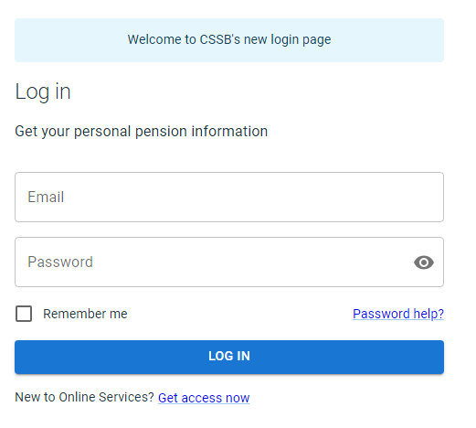
cssb.mb.ca
Notes:
CSSB Online Services provide an easy and secure way to access your pension and group insurance information, both before and after retirement.
A great feature about the Online Services site is that members are able to complete their retirement forms, which is quick and convenient for most people. We encourage you to register if you haven’t already done so.
An email address will be required to register, and it is recommended to use your home email address since your work email would not be of any use after retirement.
For members that have already registered online and who happen to forget the password, you don't have to go through the registration process again, you can click on "Forgot Password" located on the main login page of Online Services.

Slide 54
Online Services Pension Estimate
Notes:
Here is a screenshot of our Online Services Dashboard once logged in, and to the left-hand side, there is a list of the many services offered online. These features can be used throughout your career such as Account History and some you’ll want to use when completing your retirement forms and I’ll focus on those today.
I’ll start off with the first arrow pointing to the Document Centre at the top left-hand corner. The Document Centre is used to securely and easily exchange documents with the CSSB - it’s a "Send & Receive" tool. Whether you're an employee or retired member, you will receive documents from us and access them from your Inbox. It also allows you to send us documents.
This is useful when your receiving your retirement estimate package and remitting the signed retirement forms.
I’ll jump to the 3rd arrow for the Insurance Estimate. Here you can run different life insurance estimates, as an employee or a retiree, based on all levels and/or different salary. After you run an estimate, a printable version will automatically be sent to your online services Inbox.
Next is the Register for Group Seminars tab. CSSB offers half-day sessions designed for employees who are planning for retirement. They are presented in-person throughout Manitoba and are also offered live online.
The Pre-Retirement Seminar schedule and registration information are available on our website and through your online account.
Income Tax Estimate. To get a better idea of the net amount of pension you will received, you can use this tax estimate to get an approximate amount of income tax would be deducted based on your monthly gross amount, if any.
I’ll now expand a bit more on the arrow pointing to Pension Estimate.

Slide 55
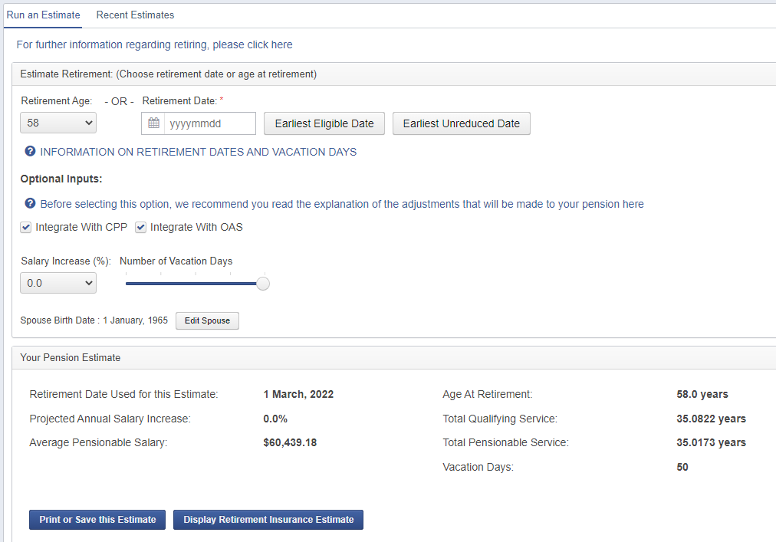
Online Services Pension Estimate
Notes:
After clicking “Pension Estimate” it brings you to this next screen.
Here you can run pension estimates according to a specific retirement age or date. Or you can have the system run an estimate at your earliest eligible date or your earliest unreduced date.
You’ll likely want to run several pension estimates to help determine the retirement date that is best for you. You can run estimates with and without banked vacation days you plan on cashing out at retirement.
If you haven’t yet added your spouse’s information to your online account, you can do so by clicking “Edit Spouse” located under the Vacation days. This will allow you to see the joint survivor pension options when you run a Pension Estimate. Alternatively, you can use the “Edit my Profile” feature accessible from the dashboard.

Slide 56
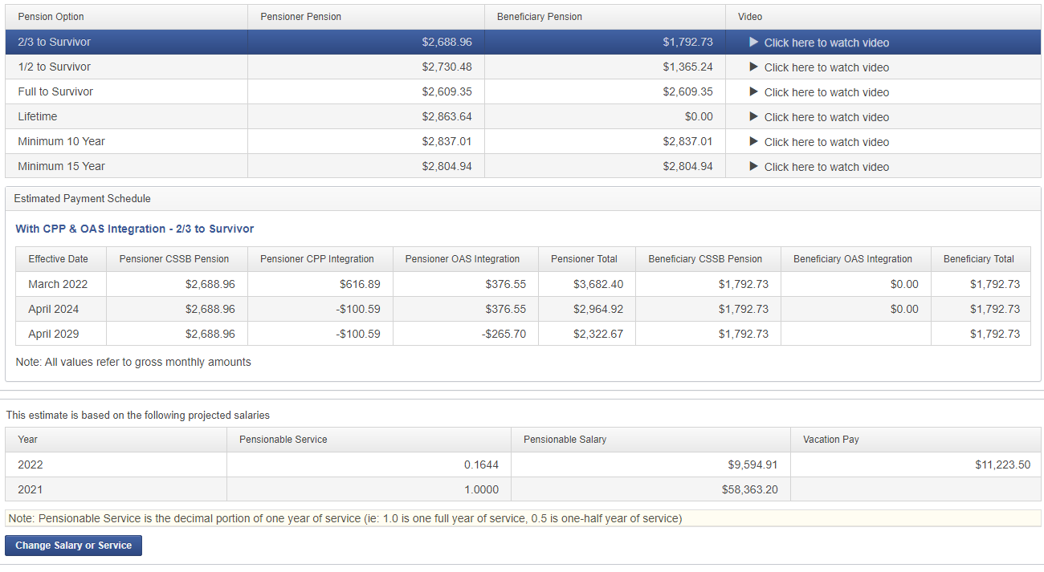
Online Services Pension Estimate
Notes:
After clicking “Pension Estimate” it brings you to this next screen.
Here you can run pension estimates according to a specific retirement age or date. Or you can have the system run an estimate at your earliest eligible date or your earliest unreduced date.
You’ll likely want to run several pension estimates to help determine the retirement date that is best for you. You can run estimates with and without banked vacation days you plan on cashing out at retirement.
If you haven’t yet added your spouse’s information to your online account, you can do so by clicking “Edit Spouse” located under the Vacation days. This will allow you to see the joint survivor pension options when you run a Pension Estimate. Alternatively, you can use the “Edit my Profile” feature accessible from the dashboard.

Slide 57
ARE YOU READY TO RETIRE?
57

Slide 58
Key Decisions
Determine your retirement date
Ways to increase your pension
banking vacation days
service purchase
Select a pension option
Consider integration option
Continue or convert your life insurance
Retiree extended health insurance
You can contact Member Services for pension estimate(s) and forms.
We also provide meetings by phone, virtual or in-person.
Notes:
Starting your pension isn’t difficult but you’ll need to make a number of decisions leading up to your retirement:
First of all, you need to determine your retirement date and inform our office by applying to start your pension. This is a separate step from notifying your employer about your retirement date.
You need to decide if and how many vacation credits you’ll bank to cash out at retirement. Contact your employer if you’re looking for information about banking vacation.
If you have periods of employment that aren’t included as pensionable service, you may want to investigate purchasing all or some of that service. Purchasing eligible past service may increase your monthly pension.
You need to select a pension option. Running pension estimates through your online services account or requesting them from our office can help you understand your options.
You can choose whether you’d like to integrate your pension with Canada Pension Plan and/or the Old Age Security pension. You should contact Service Canada directly about estimating those values and applying to commence those benefits.
You need to decide regarding your group life and dependents insurance and retiree health insurance in retirement.
You’ll have to choose how you want to apply to start your pension – online or on paper. Your pension does not start automatically!
I encourage you to view all of the segments that make up the pre-retirement seminar to help you make these important decisions.
CSSB staff can answer your pension and insurance questions or help you complete your retirement forms by phone, email, in person and in virtual meetings.

Slide 59
Retirement Forms
If you want your pension to start, you must submit your completed retirement forms to our office PRIOR to your retirement date (4-6 weeks in advance)
You will receive confirmation letters before your pension commences
You must provide notice to your employer
Your retirement date is the last day you are employed, and your pension effective date is the day after but may depend on when your forms are provided to CSSB.
Notes:
If you want the pension to start…
You must submit your completed retirements form to our office PRIOR to your retirement date.
Once the retirement forms are received by the CSSB, they are reviewed to ensure they have been fully completed, timelines have been met and supporting documents have been provided. Confirmation letters are then generated and uploaded to your online services Inbox. Please look out for those letters within a few weeks after remitted your forms. If you haven’t received them, it’s important to follow-up with our office prior to your retirement date.
Your choice of retirement date is between you and your employer. The pension plan allows a retirement date to be any day of the year, even if it’s a day you don’t normally report to work. Your retirement date is the last day you are employed and your pension effective date is the day after, but it depends on when your forms are provided.

Slide 60
Complete Retirement Forms Online
Applying for Retirement Online
video segment available
Notes:
Near the bottom of the list, you will see the feature that allows members to Complete Retirement Forms online. Keep in mind that this will only appears when you are eligible to retire so if you are looking at the online services dashboard at age 53, you’re not going to see the Complete Retirement Forms option as you are not within 6 months of your retirement date.
This option will appear if you are 6 months prior to turning age 55, or after age 55.
.

Slide 61
Complete Retirement Forms Online
Notes:
Completing your retirements forms online is a 10-step process that will take you through your decisions.
You can see for the first step it's asking you to select your retirement date. The next option is the spousal information. As you go along the process, you can click on "Next," but you also have the option available to "Save for Later“ if you need to.

Slide 62
Complete Retirement Forms Online
Notes:
Once you’ve gone through the steps, this is the screen where you will be able to either print the forms yourself, sign and return them to our office, or if you need, our office print them for you and mail them to your home.
You'll have to sign the one page 2-sided form outlining a summary of the options and items selected. At this point, you may have to provide additional information such as proof of age and the waiver forms which would have to be submitted to our office along with the signed retirement forms.
Once the summary is signed, we encourage members to use the Document Centre – it’s the most reliable, fastest, secure way of submitting the forms. You can take a picture and send it through the “Send Documents” feature.
Completed forms should be submitted to our office ideally anywhere from 2-3 months in advance if you want to ensure you receive your first pension payment on time.

Slide 63
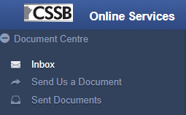
Complete Retirement Forms Online
Additional Requirements
Proof of age for member and spouse/partner
Manitoba Pension Commission Forms (if applicable)
Form 5A – Waiver of 60% Joint Survivor Pension
Form 5B – Consent for Integrated Pension
Submit your forms via
Online Services
Fax
Drop-off
Mail
Notes:
You will notice the key decision we discussed earlier are related to what you’ll be asked when you apply for pension. Now that you’ve investigated those decision and feel comfortable with them – completing your retirement forms is an easy process.
When completing your application you will be asked to provide your date of retirement.
Your relationship information – We need to know if you have a spouse or common-law partner when you retire, as that affects the pension options that are available and the rules that apply.
Your selected pension option – Do you want your pension to continue to someone once you pass away?
Do you want to integrate your pension with CPP and/or OAS benefits?
You’ll also need to select whether you want to continue your life insurance into retirement.

Slide 64
What to expect after you start your pension
Pensions are paid by direct deposit on the second last banking day (Monday to Friday) of the month.
Your pension will be paid on an interim basis for a few months.
Monthly Pension Statements are available online.
Keep your contact information up-to-date
Notes:
After you’ve applied for pension, this slide provides information on what to expect.
Once the retirement forms are received by the CSSB, they are reviewed to ensure they have been fully completed, timelines have been met and supporting documents have been provided. Confirmation letters are then generated and uploaded to your online services Inbox. Please look out for those letters within a few weeks after remitted your forms. If you haven’t received them, it’s important to follow-up with our office prior to your retirement date.
Pensions are paid by direct deposit the second last banking day (Monday to Friday) of the month.
Upcoming payment dates are posted in the Pensioner section of the CSSB website and posted to your online account after retirement. Depending on your retirement date and when your forms are received in our office, your first payment may be processed for the end of the month that you retire.
We can start to pay your pension before your employer has notified us about your retirement and, until your final service and salary information have been received, your pension will be paid on an estimated basis.
As a result, this pension could be quite a bit lower (as much as 20%) than the pension estimates you have viewed. When the information has been reported by your employer, your final pension will be calculated. A one-time adjustment will be made to make up for any difference between the pension amounts you’ve received and what you should have received.
We provide monthly statements indicating your pension amount, deductions or adjustments made to your payment can be viewed anytime online. However, you will receive a email notifications when there is a change in the pension amount deposited to your account.
Lastly, it’s important that you notify CSSB of any changes to your contact information, either through the Edit My Profile feature of your Online Services Account, or by contacting the Board office. This will ensure that you continue to receive your payments and relevant information regarding your pension.

Slide 65
ADJUSTMENTS TO YOUR PENSION AFTER RETIREMENT
Adjustments to your Pension
video segment available
65
Notes:
In addition to the integration adjustment at 60 and 65…

Slide 66
Pension Payments – Interim payment
Generally, pension payments will be less than anticipated (+/- 10%) for the first 3-6 months.
Pension calculation will start based on most recent year’s verified service and earnings - typically December 31st in the prior year.
Pension payment will change as current service, earnings, vacation pay, insurance, income tax are updated.
Notice will be sent to you when your account has been finalized. Any retroactive payment will be made if you’ve been underpaid while paid on an interim basis.
Notes:
Pension estimates that are prepared by the CSSB or in your online services account are using the previous year's reported service and salary information from your employer. This information is used to project future earnings for pension estimates. This will at least provide you with something to plan and work with.
We don’t start paying members with the projected pension amount, instead we pay using the data that we have on file. This wouldn’t include current service, earnings and vacation pay since that data won’t come to us until several weeks after your retirement date.
Therefore, pension payments will start approximately +/-10% less than first anticipated.
Adjustments will be made to service, earnings, vacation pay, group insurance, and income tax as we move along towards finalizing your pension account. A letter will be sent to you once the account has been finalized.
At that point we would compare the amount paid from your retirement date to the amount that should have been paid. Any amount owed will be paid in the month your account has been finalized.

Slide 67
Cost-of-Living Adjustment (COLA)
First COLA paid in the 13th month following retirement and then each July thereafter
Up to 2/3 of the increase in Consumer Price Index (Canada)
Granted to the extent the COLA account can fund them
Future COLAs are not guaranteed
Notes:
Another possible adjustment to your pension is the Cost-of-Living Adjustment, which is also called COLA.
It’s used to reduce the effects of inflation and what's nice about COLA provisions, the value continues to your surviving spouse or common-law partner upon your passing.
The annual increase can be up to 2/3 of the increase in Consumer Price Index for Canada. Your first COLA is paid in the 13th month following your retirement, and then every July thereafter.
A portion of employee contributions go into a separate COLA account, and COLA's are basically granted to the extent that that separate account can fund them.
Future COLAs are not guaranteed.
If you wanted more information, and are interested in seeing a historical list of past COLA increases, you can visit our website.
**Message from Erin and Bruce (Jan. 3, 2024):
The COLA account is under pressure and the situation is not likely improving in the near term. We would like the pre-retirement seminar to go beyond the message that COLA is not guaranteed. We want members to understand that there may be very limited inflation protection through future COLAs, as this may influence their retirement timing.
If members are concerned, we want members to know to get in contact with the Liaison Committee or to tell their employer.

Slide 68
Cost-of-Living Adjustment (COLA)
The actuary and CSSB are concerned that if changes are not made, the COLA account will be unable to meet the targeted 2/3 (66.6%).
year | % of CPI increase
2022 | 41.3%
2023 | 24.9%
2024 | 35.3%
Liaison Committee
204-954-7300
SILC@ellement.ca
liaisoncommittee.org
Notes:
Another possible adjustment to your pension is the Cost-of-Living Adjustment, which is also called COLA.
It’s used to reduce the effects of inflation and what's nice about COLA provisions, the value continues to your surviving spouse or common-law partner upon your passing.
The annual increase can be up to 2/3 of the increase in Consumer Price Index for Canada. Your first COLA is paid in the 13th month following your retirement, and then every July thereafter.
A portion of employee contributions go into a separate COLA account, and COLA's are basically granted to the extent that that separate account can fund them.
Future COLAs are not guaranteed.
If you wanted more information, and are interested in seeing a historical list of past COLA increases, you can visit our website.
**Message from Erin and Bruce (Jan. 3, 2024):
The COLA account is under pressure and the situation is not likely improving in the near term. We would like the pre-retirement seminar to go beyond the message that COLA is not guaranteed. We want members to understand that there may be very limited inflation protection through future COLAs, as this may influence their retirement timing.
If members are concerned, we want members to know to get in contact with the Liaison Committee or to tell their employer.

Slide 69
Income Tax Changes
Rates subject to change in January each year
You may increase the amount of tax withheld at any time by contacting our office
NEW FOR 2025: Update your banking information and your income tax deductions through your online services account
Notes:
Pension payments are considered taxable income and subject to income tax withholding. To help us determine how much income tax will be deducted from your pension, you will be provided with a set of TD1 forms (Federal and Provincial) in your retirement package.
We are required to withhold the minimum amount depending on how you complete the TD1 forms.
If you are planning to live outside of Canada, you will be taxed a flat percentage of non-resident tax, based on the agreement between Canada and the country in which you reside.
You have the option to increase the amount of tax withheld at any time by sending something in writing to our Pension department or email at askus@cssb.mb.ca.
We will provide a T4A at the end of the year to complete your income tax return.

Slide 70
LIFE EVENTS
70
Notes:
In addition to the integration adjustment at 60 and 65…

Slide 71
Death of the Member
Monthly pension benefits may continue after the member’s death depending on the pension option chosen at retirement.
Prompt notification of death will prevent pension overpayments which must be repaid
Update your beneficiary(ies)
COLA:
Partner/beneficiary is entitled to 2/3 of cumulative and future
Continues to be paid to partner/beneficiary until pension guarantee ends or death
Notes:
Monthly pension benefits may continue after the death of the member, depending on the plan option you selected.
If the pension is continuing, you or your partner/beneficiary should be aware of the following:
Prompt notification of death will prevent pension overpayments which must be repaid.
Insurance beneficiary can be updated
- The partner/beneficiary will be entitled to 2/3 of the cost of living adjustment (COLA) payment - both the cumulative COLA (from start of pension) to date,
- In addition, COLA will continue to be paid to the partner/beneficiary until the pension guarantee option has ended or death.

Slide 72
Relationship Separation
The CSSB may be required to divide the pension earned during a marriage/common-law relationship UNLESS both parties agree in writing to not divide the pension.
Date of physical separation determines the rules in effect
Court order or written agreement required for division
Relationship Separation
video segment available
Notes:
Where a plan member has had a separation of a marriage or eligible common-law relationship and there is a court order or written agreement where family assets are divided, the member’s pension may be subject to division as well.
The portion of the pension subject to division is the limited to pension that is accrued during the period of the relationship. This starts at the earliest of the date of cohabitation or date of marriage, and ends at the date of separation of the relationship.

Slide 73
Important Contacts
In planning for retirement, you may also wish to contact:
Financial Advisor
Employer
Service Canada
Health insurance provider
Notes:
In planning for retirement, you may also wish to contact:
Financial Advisor
If you require assistance with your decisions. (The CSSB doesn’t provide financial advice or retirement planning)
Employer
For information on other employer benefits (such as severance benefits, vacation accruals and cash-outs, etc.) and policies or collective agreements that may be applicable
Service Canada
For information on federal benefits, such as Canada Pension Plan (CPP) and Old Age Security (OAS)
Retiree Health Insurance Carriers
For information on health insurance through MARGE (c/o Johnson Inc.) or Manitoba Blue Cross
The CSSB’s focus is your pension and insurance benefits – we don’t provide retirement planning or overall financial advice.
You may want to contact a financial advisor if you need guidance with retirement planning.
Your employer will have information on employer benefits and the rules applicable to those benefits such as severance pay. That is an employer paid benefit and is not part of the pension plan. Vacation day accruals as well as cash-outs are typically handled by your employer’s payroll department.
Contact Service Canada for information on your Federal benefits: CPP and OAS. You will want to obtain an estimate from Service Canada to find out what you would receive directly from those Federal plans at age 60 and 65.
Lastly, you may want to contact one of the two healthcare insurance providers if you wanted to continue any extended health insurance into retirement. One option is Johnson Inc. through MARGE, the Manitoba Association for Retired Government employees. The other option is Manitoba Blue Cross. Contact them directly about details on the coverage, the cost and eligibility for that coverage or to apply. The CSSB doesn’t administer these plans.

Slide 74
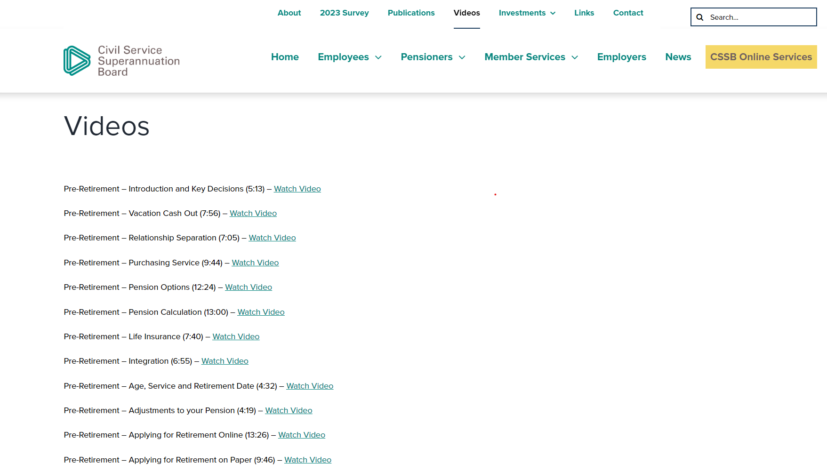
New screenshots
Notes:
Pension payments are considered taxable income and subject to income tax withholding. To help us determine how much income tax will be deducted from your pension, you will be provided with a set of TD1 forms (Federal and Provincial) in your retirement package.
We are required to withhold the minimum amount depending on how you complete the TD1 forms.
If you are planning to live outside of Canada, you will be taxed a flat percentage of non-resident tax, based on the agreement between Canada and the country in which you reside.
You have the option to increase the amount of tax withheld at any time by sending something in writing to our Pension department or email at askus@cssb.mb.ca.
We will provide a T4A at the end of the year to complete your income tax return.

Slide 75
More information
Online Services
askus@cssb.mb.ca
cssb.mb.ca
Notes:
This concludes the introduction to the CSSB Pension and Life Insurance Pre-Retirement Seminar.
Along with these video segments, I recommend reviewing the Fact Sheet “Applying for a Retirement Pension” or the Pre-Retirement Seminar Booklet, both available on our website.
If you have any questions, please feel free to connect with our office directly by phone or email. We’re here to help. Thanks.
For more information:
Online services is your source of personalized information, powerful planning tools, and secure document transmission. If you’re not yet registered, we encourage you to register for Online Services.
AskUs is our main point of contact – send us an email and we’ll help you out.
We’re generally pretty good at getting back to you same day, or next day.
Our website has a ton of great content, plus Fact Sheets in our publications section to give you a good overview of specific topics.
You can always give us a call.

Slide 76
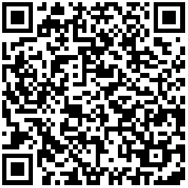
Pre-Retirement Seminar Survey Your feedback is important!
https://www.surveymonkey.com/r/NBSBT5G

